Slide 1

C Programming Introduction week 10: Arrays
Lecturer : Cao Tuan Dung
Dept of Software Engineering
Hanoi University of Technology
For HEDSPI Project

Slide 2
Arrays
A block of many variables of the same type
Array can be declared for any type
  E.g. int Arr[10] is an array of 10 integers.
Examples:
  list of students’ marks
  series of numbers entered by user
  vectors
  matrices

Slide 3
Arrays in Memory
Sequence of variables of specified type
The array variable itself holds the address in memory of beginning of sequence
Example:
int arr[10];
The n-th element of array arr is specified by arr[n-1] (0-based)
0
1
2
3
4
5
6
7
8
9
arr

Slide 4
Initialization
Like in the case of regular variables, we can initialize the array during declaration.
the number of initializers cannot be more than the number of elements in the array
  but it can be less
  in which case, the remaining elements are initialized to 0

Slide 5
Initialization
if you like, the array size can be inferred from the number of initializers by leaving the square brackets empty
  so these are identical declarations :
    int array1 [8] = {2, 4, 6, 8, 10, 12, 14, 16};
    int array2 [] = {2, 4, 6, 8, 10, 12, 14, 16};

Slide 6
Example: Initialization with for statement
Create an array of even numbers from 2 to 20. Print the content of this array.
#include <stdio.h>
#define arraySize 10
int main()
{
int s[ arraySize ]; // array S has 10 elements
int i;
for ( i = 0; i < arraySize; i++ )
s[ i ] = 2 + 2 * i;
printf("Element \t Value\n");
for ( i = 0; i < arraySize; i++ )
printf("%d\t%d\n", i, s[i]);
return 0;
}

Slide 7
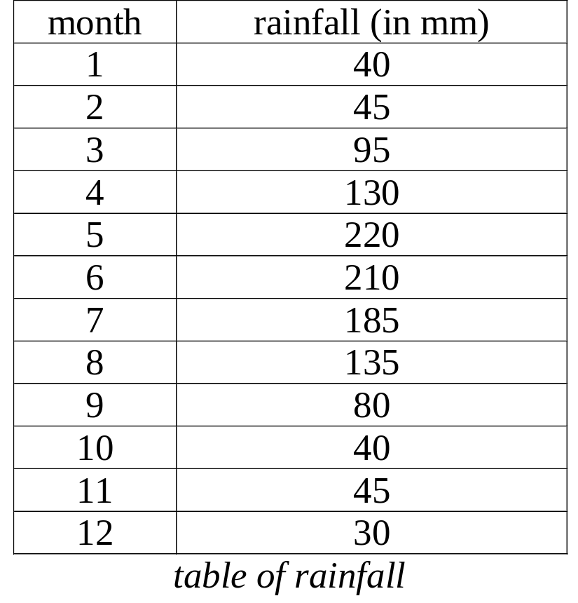
Data input and output for array
Running a for loop, in each loop:
  use data input functions like scanf
or
  use data output functions like printf

Slide 8
Example
#include <stdio.h>
#define MONTHS 12
/* store and display rainfall in all months of the year */
int main()
{
int rainfall[MONTHS];
int i;
for ( i=0; i < MONTHS; i++ ){
printf("Enter the rainfall(mm):"); scanf("%d", &rainfall[i] );
}
/* Print from January to December */
for ( i=0; i < MONTHS; i++ ) {
printf( "%5d ” , rainfall[i]);
}
printf("\n");
return 0;
}

Slide 9
Exercise 10.1
1) Write a program to input an array that stores 100 integers.
  a) Find the sum of the odd number in the array
  b) Find the minimum value.

Slide 10
Solution 10.1
#include <stdio.h>
#define MAX 100
int main()
{
int a[MAX];
int i,s,min;
for ( i = 0; i < MAX; i++ ){
printf("a[%d]=",i);scanf("%d", &a[i]);
}
s=0; min=a[0];
for ( i = 0; i < MAX; i++ ){
if (a[i] < min) min = a[i];
if (a[i]%2==1) s= s+ a[i];
}
printf("\nMinimum value in the array: %d",min);
printf("Sum of all odd numbers: %d",s);
return 0;
}

Slide 11
Exercise 10.2
Given an array of which elements are the numbers inputed by user. Find the sum of the local maximum numbers in this array (local maximum element is the element that greater than its two neighbours)

Slide 12
Solution
.. // Array data input
sum=0;
for (i=1; i<=size-1; i++)
if (a[i]>=a[i-1] && a[i]>=a[i+1]) sum +=a[i];

Slide 13
Arrays as function arguments
Functions can accept arrays as arguments
Usually the array’s size also needs to be passed (why?)

Slide 14
Arrays as function arguments
For example:
int calc_sum(int arr[], int size);
Within the function, arr is accessed in the usual way
Changes in the function affect the original array!!

Slide 15
Example
int calc_sum(const int arr[], int size)
{
int i = 0;
int sum = 0;
for (i = 0; i < size; ++i)
sum += arr[i];
return sum;
}

Slide 16
Exercise 10.3
Implement a function that accepts two integer arrays and returns 1 if they are equal, 0 otherwise
Write a program that accepts two arrays of integers from the user and checks for equality

Slide 17
Solution
int compare_arrays(const int arr1[], const int arr2[], int size)
{
int i = 0;
for (i = 0; i < size; ++i)
{
if (arr1[i] != arr2[i])
return 0;
}
/* if we got here, both arrays are identical */
return 1;
}

Slide 18
Exercise 10.4
Write two functions:
  the first sorts the integers element in an array by the decreasing order.
  the second sort the odd elements in the decreasing order.
Write a program that asks user to enter 10 intergers and displays the results after two styles of sorting above.

Slide 19
Solution: Sorting in descending order
void DesSort (int a[], int n)
{
int tmp;
for (i = 0; i < n-1 ; i++)
for (j = i+1; j < n; j++)
if (a[i] < a [j]) {
tmp=a[i];
a[i]=a[j];
a[j]= tmp;
}
}
}

Slide 20
Sorting odd numbers
void OddSort (int a[], int n)
{
int tmp;
for (i = 0; i < n-1 ; i++)
for (j = i+1; j < n; j++)
if (a[i]<a[j] && (a[i]%2) && (a[j]%2)) {
tmp=a[i];
a[i]=a[j];
a[j]= tmp;
}
}
}

Slide 21
Exercise 10.5
Given an integer array:
  Count the number of the number 0 in this array.
  Find the length of the subsequence that consists the consecutive numbers (all of elements are number 0).
  Find the time of appearance of numbers.

Slide 22
Solution for question a)
Traverse the array,when program meet an element 0, increment the counter.
count=0;
for (i=1; i<n; i++)
if (a[i] ==0)
count++;

Slide 23
Solution for question b)
int max=0,temp=0;
for(i=0;i<n;i++)
{
if(a[i]==0)
temp=temp+1;
if(a[i]!=0){
if(temp>max){
max=temp;
temp=0;
}
}
}
if (temp>max) max=temp;
printf("Do dai day con bang 0 lon nhat la:", max);

Slide 24
Solution for question c)
Firstly we sort the array, then count the number of equal elements just after each element.
#include<stdio.h>
void swap(int *a,int *b)
{
int temp;
temp=*a;
*a=*b;
*b=temp;
}

Slide 25
Solution for question c)
void main()
{
int n,a[100],i,j,dem;
printf("Enter the number of elements in array:"); scanf("%d",&n);
for(i=0;i<n;i++) {
printf("a[%d] = ",i); scanf("%d",&a[i]);
}
for(i=0;i<n-1;i++)
for(j=i+1;j<n;j++)
if (a[i]>a[j]) swap(&a[i],&a[j]);
i=0; j=0; dem=0;
while (i<n) {
dem=0;
j=i;
while (a[i]==a[j]) {
dem++; j++;
}
printf("\n%d occurs for %d times in array",a[i],dem);
i=j;
}
}

Slide 26
Multi-dimensional arrays
Array of arrays:
int A[2][3] = { {1, 2, 3},
{4, 5, 6} };
Means an array of 2 integer arrays, each of length 3.
Access: j-th element of the i-array is
A[i][j]
1
2
3
4
5
6

Slide 27
Example: Matrix addition
#include <stdio.h>
#define SIZE 3
int main()
{
int A[][SIZE] = {{1,2,3}, {4,5,6}, {7,8,9}};
int B[][SIZE] = {{1,1,1}, {2,2,2}, {3,3,3}};
int C[SIZE][SIZE];
int i = 0, j = 0;
    for (i = 0; i < SIZE; ++i)
    for (j = 0; j < SIZE; ++j)
    C[i][j] = A[i][j] + B[i][j];
return 0;
}

Slide 28
Exercise 10.6
Write a program that defines 3 matrices A,B,C of size 3x3 with int elements; initialize the first two matrices (A and B)
Compute the matrix multiplication of A and B and store it in C (i.e. C = A*B)
Print all the matrices on the screen

Slide 29
Solution
#include <stdio.h>
void main() {
float a[3][3], b[3][3], c[3][3];
int m,n,p;
int i,j,k;
float temp;
for(i=0; i<3; i++){
  for (j=0; j<3; j++) {
  printf("a[%d][%d]=", i+1, j+1);
  scanf("%f", &temp);
  printf("b[%d][%d]=", i+1, j+1);
  scanf("%f", &temp);
  b[i][j]= temp;
  }
  }
...

Slide 30
Solution
  for(i=0; i<3; i++){
  for (j=0; j<3; j++) {
  c[i][j]=0;
  for (k=0; k<n; k++)
  c[i][j]= c[i][j]+ a[i][k]*b[k][j];
  }
  }
  printf("\n Matrix A:");
  for(i=0; i<3; i++){
  printf("\n");
  for (j=0; j<3; j++) {
  printf("%2.2f\t", a[i][j]);
  }
  }
  ...

Slide 31
Solution
  printf("\n Matrix b:");
  for(i=0; i<3; i++){
  printf("\n");
  for (j=0; j<3; j++) {
  printf("%2.2f\t", b[i][j]);
  }
  }
  printf("\n Matrix c:");
  for(i=0; i<3; i++){
  printf("\n");
  for (j=0; j<3; j++) {
  printf("%2.2f\t", c[i][j]);
  }
  }
}

Slide 32
Exercise 10.7
Input an array with the number of element n asked from user. Check to see whether the array is symmetric.

Slide 33
Solution
#include <stdio.h>
int checkSymmetric(int a[], int n);
void main()
{
int a[100],n,i;
printf(" Number of elements: ");
scanf("%d",&n);
for(i=0;i<n;i++)
{
printf("a[%d]= ",i);
scanf("%d",&a[i]);
}
printf("\n Array's content:\n");
for(i=0;i<n;i++)
printf("%d ",a[i]);
if(checkSymmetric(a,n))
printf("\n array is symmetric");
else
printf("\n array is not symmetric ");
}
int checkSymmetric (int a[],int n)
{
int i=0,j=n-1;
while(i<=j)
{
if(a[i]!=a[j]) return 0;
i++;
j--;
}
return 1;
}

Slide 34
Exercise 10.8
Write a function that reverse the array content. Use this function in a program that asks user to enter a list of floatting numbers.
Then reverse all these numbers without creating another array.

Slide 35
Solution
void reverse(float a[],int size)
{
int i;
float tmp;
for (i=0; i<n/2; i++)
{
tmp=a[i]; a[i]=a[n-i-1];
a[n-i-1]=tmp;
}
}

